Slide 1

Home Appliance Control Using Android Application review 2:
VIT BHOPAL UNIVERSITY
SCHOOL OF ELECTRICAL & ELECTRONICS ENGINEERING
B .Tech. Topic-Approval & Progress Presentation On
NAME REG.NO.
YASH CHANDAK - 20BAC10026
ANIKET VERMA - 20BAC10042
SHIVAM LANDGE - 20BAC10046
GUIDED BY - DR.CHANDAN KUMAR

Slide 2

OVERVIEW OF THE PRESENTATION:
OBJECTIVE.
LITERATURE REVIEW.
COMPONENTS USED
METHODOLOGIES.
PROGRESS OF WORK TILL NOW.
CONCLUTION.

Slide 3

OBJECTIVE
1
Let’s start with the first set of slides

Slide 4
Description of the project
Home Appliances Controlling using Bluetooth project is a fine combination of Android mobile technology and embedded system.
The user can control Home appliances using Android mobile. An Android application should be installed on his/her Android mobile handset to control various home appliances.
The user can send commands using that application.
This project consists of a Bluetooth receiver.
This Bluetooth device is connected to the circuit which has a decoder.
This decoder sends a code for the respective command sent by the user. Then the respective device connected to the circuit will be turned on or off depending on the command given.
At the output side of Home Appliances Controlling using Android Mobile via Bluetooth, we have connected 4 relays.

Slide 5
LITERATURE REVIEW
2

Slide 6
LITERATURE REVIEW:
Design and Implementation of a Microcontroller Based Home Automation System Using “MIT Remote App”, explore the use of television remote to control home appliances, this is not efficient as users have to be physically present to activate the system by pointing the remote towards the appliance.
This paper is written to implement a smart home automation system with enhanced authorisation and security practices, considering the detailed description of different technologies present nowadays
.
This work is done by keeping in mind the various smart home systems like central controller-based smart home systems, Bluetooth-based smart home systems and Internet-based smart home systems. The work is concluded by giving future directions smart home Security Research

Slide 7
COMPONENTS REQUIRED
3

Slide 8
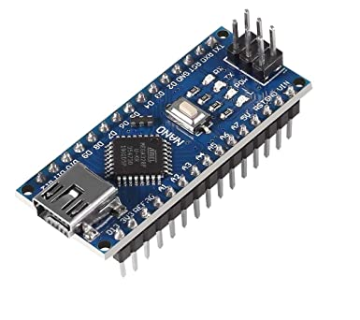
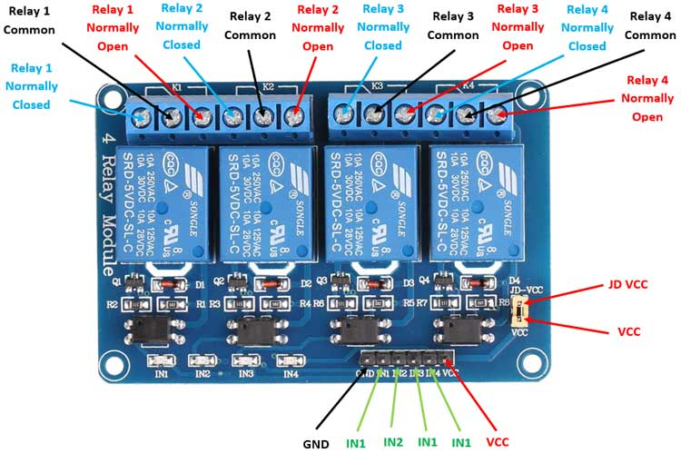
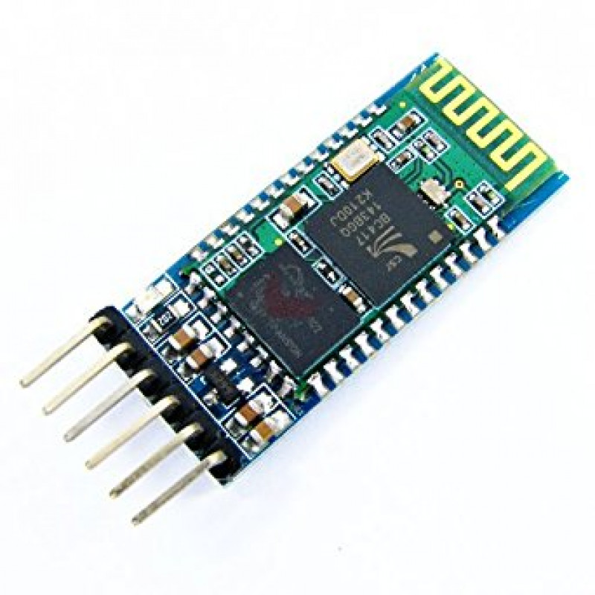
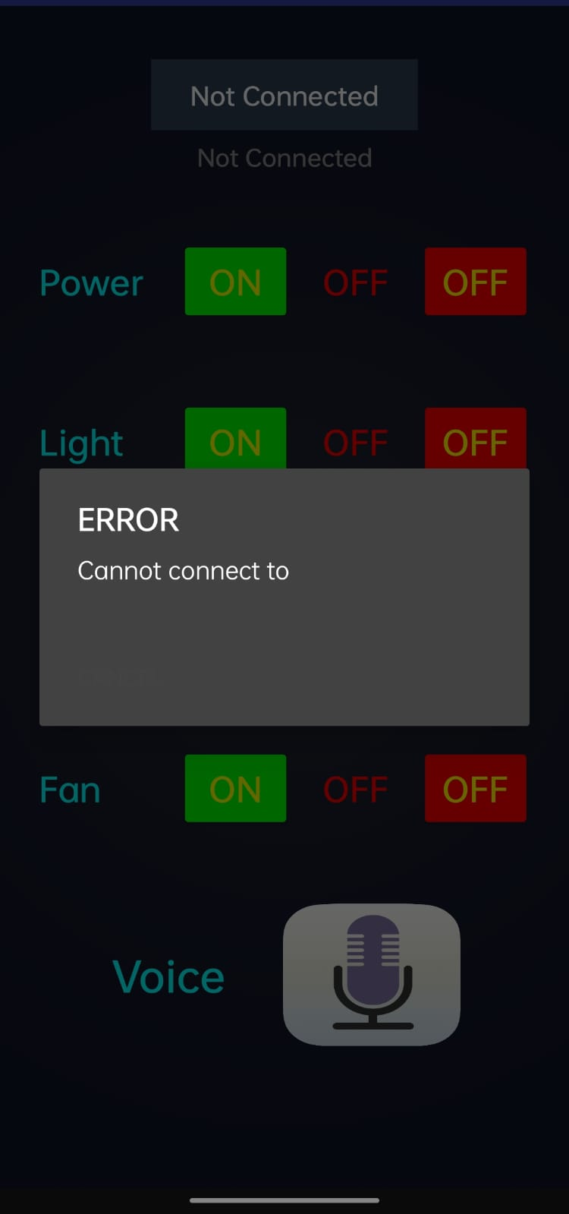
COMPONENTS WE HAVE USED IN THIS PROJECT
ARDUINO NANO
4 WAY RELAY
BREAD BOARD
JUMPER WIRE
HC – 05 BLUETOOTH MODULE
5 VOLT POWER SUPPLY
SMARTPHONE

Slide 9
4

Slide 10
METHODOLOGY
Firstly, Arduino nano is powered through a 5V supply(or a laptop).
Arduino nano is programmed via ARDUINANO IDE software on the laptop.
HC-05 bluetooth module is connected to Arduino nano board via jumper wires.
Further, arduino nano is connected to the relay board via jumper wires.
Now, one of the wire of the home appliance(LED Bulb) is connected to the relay board whereas the other wire is connected to power supply.
A single piece of wire is connected from relay board to the power supply.

Slide 11

PROGRESS WORK TILL NOW
5

Slide 12
PROGRESS WORK:
We are working on the project since the semester started and we have seen many papers and references to go with the model.
Basic to intermediate information has been researched about the Arduino NANO board.
It work on the software as well as on hardware to go with the android application to get outcome .
Code for the working of the circuit simulation has been written successfully.
We have been done with the mobile application in phone.

Slide 13
CONCLUTION
6

Slide 14
CONCLUTION
The system as the name indicates, ‘Home automation’ makes the system more flexible and provides attractive user interface compared to other home automation systems.
The system consists of mainly three components is a BLUETOOTH module, Arduinano microcontroller and relay circuits.
This proposes a low cost, secure, easily accessible, auto-configurable, remotely controlled solution.
Hence we can conclude that the required goals and objectives of home automation system have been achieved.

